Slide 1

Improving Breda
By TeamEight

Slide 2
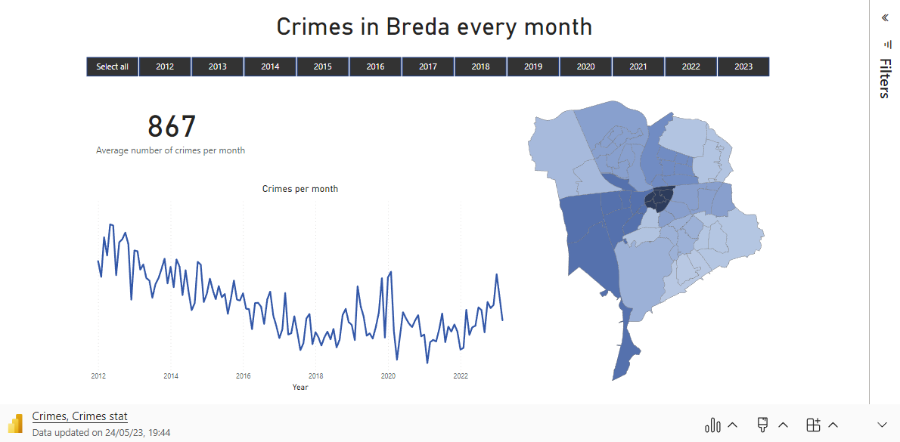
Problem Statement

Slide 3
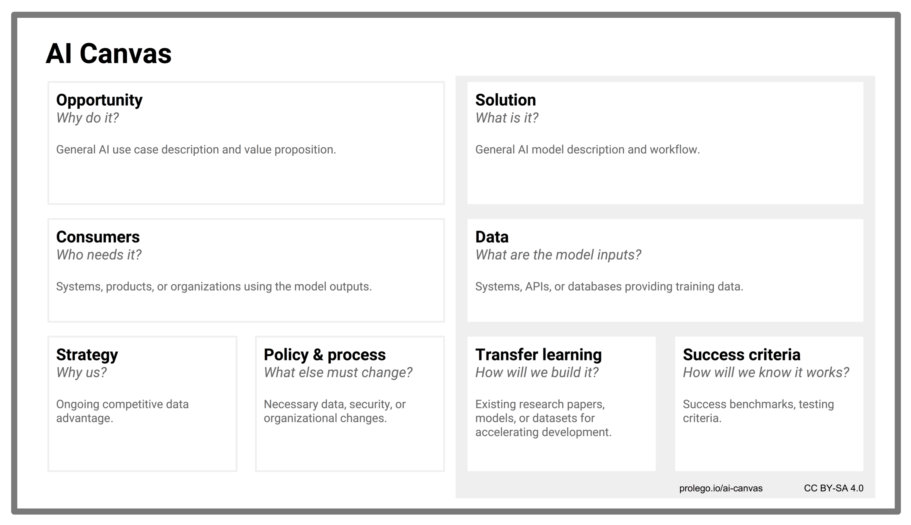
Crimes in Breda are affecting public safety and livability in the city. There is a need for tool to help creating safer communities and supporting effective policing.
Creating machine-learning algorithm that predicts crimes per month in different neighborhoods and dashboards that to get valuable insights.
The tool will be in use of Municipality and Police Department to prevent crimes and analyze factors of the high crimes rates
Social-economics, city facilities, weather, education level, emergency response times, Labor participation data and migration data.
As the group of ambitious, creative students we can provide new approach towards solving the issue
The tool can be associated with several disruptive technology risks and be biased
The model will be trained using Gradient Boosting Regression. The Big Data approach will be used to build the model
For success of the project, the model should not be biased and have low MAE
(<2.00)

Slide 4
Solution
What is needed ?
Tool to help Municipality analyze crimes factors and take actions towards lower crime rates.
Tool to help making decision for city development, considering public safety.
Tool to make the Policing process more effective
How to achieve that ?
Create machine-learning algorithm that predicts crimes per month in different neighborhoods based on data that includes social, city facilities, weather and more.
Creating dashboards that using algorithm allows user to change features in order to get valuable insights.

Slide 5
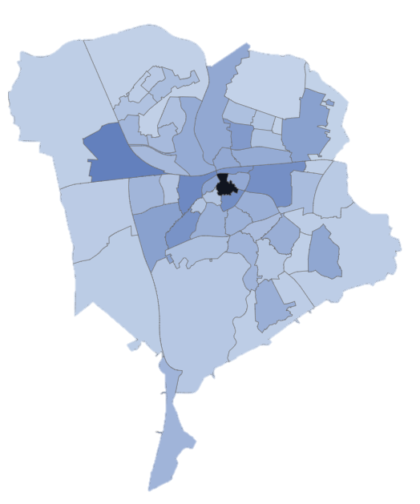


Product prototype
MORE SUPERMARKETS………
MORE LIGHTS ……................
NEW GREEN SPLACES ………
PREDICTED CRIMES NEXT MONTH ………..
41
55
44
41

